Slide 1
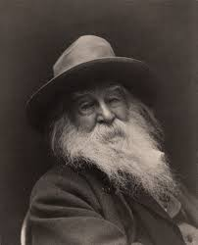
Walt Whitman
One of the Fireside Poets

Slide 2
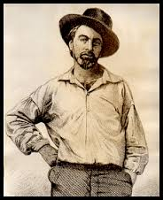
Romantic journalist, editor and poet
1819-1892
Celebrates the spirit of the individual
A non-conformist = evidence: free verse
A true patriot – often praises America in his works = evidence: “The United States themselves are essentially the greatest poem.”
Reflects democracy/individuality = evidence: his writing touches on all aspects of daily, common life; the unique and the mundane, the beautiful and the ugly
Reflects both rural and urban experiences (he had many life experiences from teacher to carpenter to nurse)

Slide 3
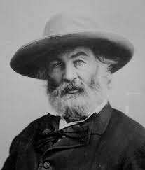
Leaves of Grass
Compilation of 400 poems – his life’s work
Ahead of his time – poems not well received
Considered too radical, too sexual, too raw, too barbaric
One of his few supporters was Ralph Waldo Emerson (transcendentalist, a fellow non-conformist)
One prominent publisher burned the book
Now considered one of the most influential books of American poetry - called brilliant by many

Slide 4
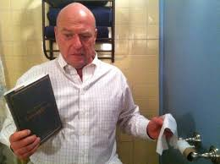
Three main poetic devices
1. Free Verse (radical at the time) No rhyme, no meter
2. Cataloging (listing)
3. Repetition (adds emphasis and rhythm)
Overall his poetry is idealistic and optimistic, but like most writers, he does criticize parts of his society.
Plus, it’s extra awesome because
the poetry is in Breaking Bad

Slide 5
“I Sit and Look Out”
1. Describe your initial reaction to the speaker’s silence.
2. Who might the speaker be and why does he/she remain silent?
3. If Whitman were writing this poem today, which sorrows would he still include? What additional sorrows might he list?
4. Provide a current example proving that this poem is still relevant today. Reference the specific line first.
5. Who/what is Whitman criticizing?

Slide 6
“I Hear America Singing”
1. How does the poem reflect Whitman’s faith in democracy?
2. Discuss the concept of singing. What does the image of America singing suggest?
3. Imagine the singing Whitman might hear were he alive today. In what ways would the “songs” be different from those he heard in his own time? How would they be the same?
4. The theme of this poem is:
5. Considering what you know of the industrial revolution, the long hours and low pay of laborers, is Whitman idealizing the voices of American workers, or are the voices truly expressions of independence and joy? Use EVIDENCE from the poem to support your response.

Slide 7
“When I Heard the Learn’d Astronomer”
Answer questions on the handout

Slide 8
“Song of Myself” (a very short version)
“Song of Myself”
Answer questions on handout, then:
This poem should remind you of another Romantic poem we’ve already read . . .
Find similarities in meaning
Find evidence to support your connections

