Slide 1
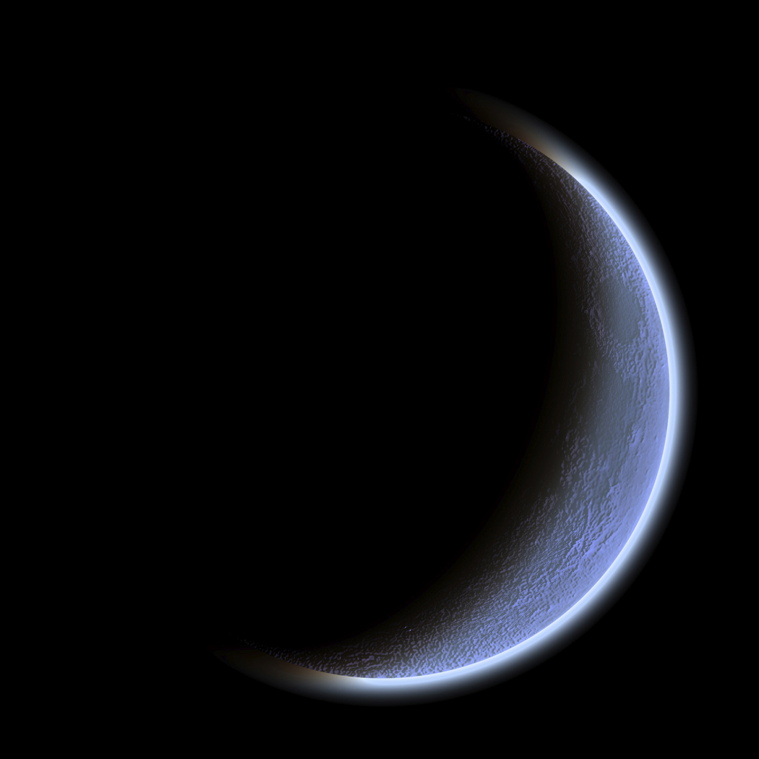
The Dark Romantics

Slide 2
Dark Romanticism
Fascinated with evil, madness, murder, and death
Stories and poems usually feature outcasts from society, personal torment, and uncertainty as to whether the nature of man will bring salvation or destruction

Slide 3
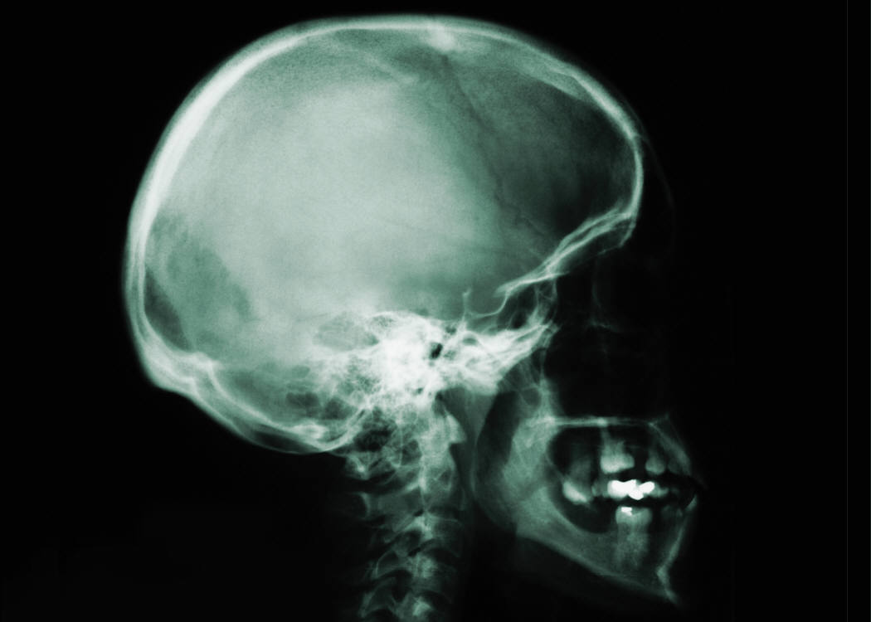
Dark Romanticism
Similarities to Romantics ideals
Feelings and intuition over intellectualism and rationality.
Fascination with “unknowable”
Natural world is dark, decaying, and mysterious; when it does reveal truth to man, its revelations are evil and hellish
Individual is prone to sin and self-destruction
Humans don’t necessarily posses wisdom and divinity

Slide 4
Question:
In Europe, this “Gothic” tradition was often set in old places: castles, manors, etc. (think Dracula, Frankenstein, etc.) But America is a young country, so where would we set our tales of the terrifying unknown? Why?

Slide 5
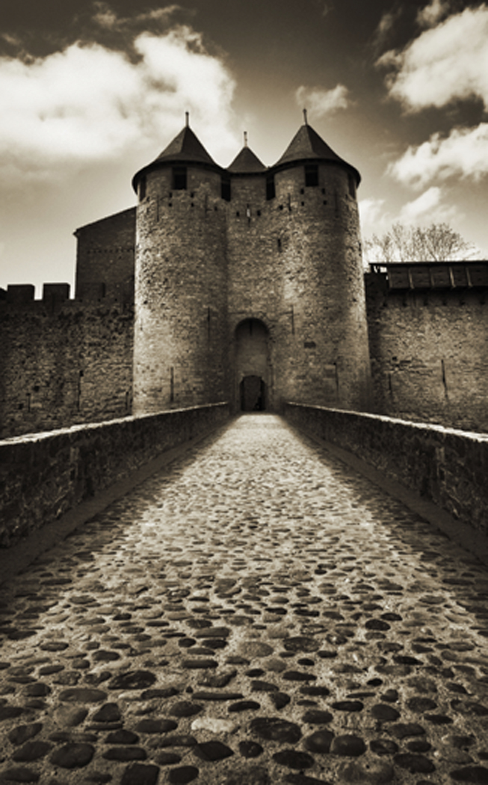
The Gothic Tradition- American Style
In Europe, Dark Romantics fascinated with creepy old castles, crypts, tombs, etc.
But America is a young country, so…
Poe- based stories in Gothic European settings
Hawthorne- resurrected old historical (Puritan) bogeymen
(Original sin, Puritan angst, shame, etc)
Melville- pitted men vs. unknowable nature

Slide 6
Literary Elements
Most stories or tales featured:
Heroic despair: hero strays from traditional ideals
Women don’t fulfill traditional roles
Villain: often misunderstood and lonely
Frankenstein’s monster, Dracula
Murder, nightmare landscapes, sea and wastelands, death, impossible love
Ambivalence: uncertainty, inability to chose

Slide 7
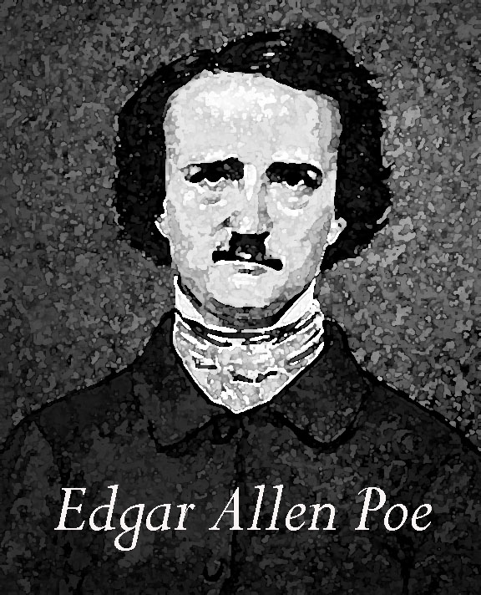
Edgar Allen Poe: Master of the Gothic
1809-1849
A life full of loss, suffering and depression
Orphaned at 3, unpleasant childhood
Dropout of West Point (intentionally expelled)
At 25, moved in with aunt and married her 13 year old daughter (yes, that is his cousin)
Editor of lit magazines- during this period did much of his writing – still poor
Tortured soul- drank heavily
Wife died of TB in 1847, sending Poe into a deathly spiral of heavy drinking- died of complications in 1849

Slide 8
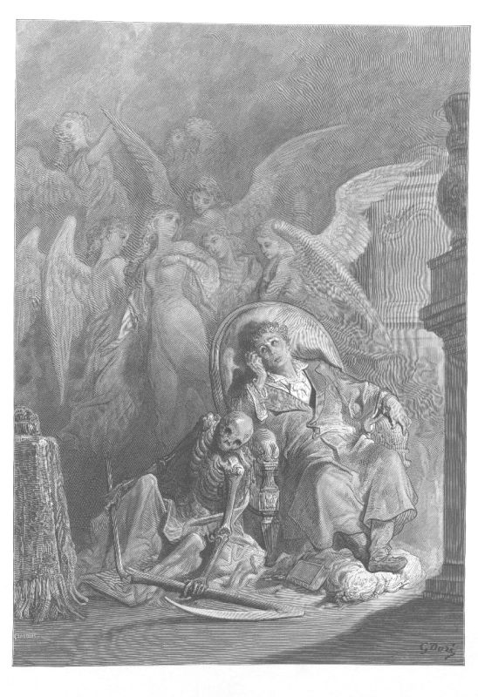
Short Stories and Poems
About either insanity or people going insane
Revenge, lost-love – frequent subjects
Goal to explore dark, irrational depths of human mind
Death in almost all stories – often linked with LOVE (his own life) “Death of a beautiful woman” is the best subject

Slide 9
Poe’s Grotesque and Arabesque
Grotesque:
Macabre, supernatural, ghosts, zombies, mutilations, premature burials, emphasis on PHYSICAL suffering
Arabesque:
Distortion of MENTAL, EMOTIONAL and spiritual nature of a person.
Terror of the soul.
Emphasis on SPIRITUAL suffering

Slide 10
Motifs in Poe (reoccurring symbols/ideas)
The EYE ( a window to the soul)
The HEART ( center of human experience, both physical and emotional)
An un-named narrator (un-reliable)
Premature burial/suffocation
Vortex – swirling, downward spiral
Dreams – porthole to inner workings of the mind

Slide 11
Summary/Overview
There is the focus on the tragic.
Belief in sin and evil.
Human nature is NOT inherently good.
An attention paid to the mysteries of life.
A mixture of the supernatural, the grotesque and the absurd
Some violence – but not gratuitous, often against innocent figures, some torture
Unbridled space VS. Confinement/imprisonment

Slide 12
Modern Gothics
Anne Rice (Interview with the Vampire)
Stephen King
“Alien” movies
Tim Burton movies (Batman, Nightmare Before Christmas, Edward Scissorhands, Beetle Juice, Sweeny Todd, etc)

