Slide 1
Puritan Life
Morals, values, God: life during the time of The Crucible

Slide 2
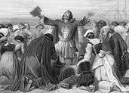
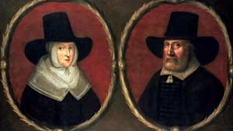
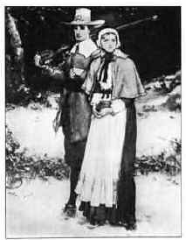
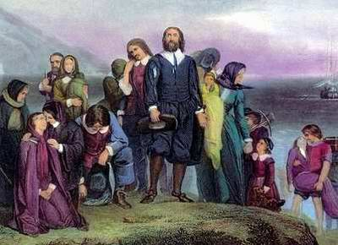

Slide 3
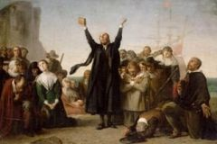
Brief History
Extreme Protestants in the 16th century
Trying to purify church by eradicating Catholicism

Slide 4
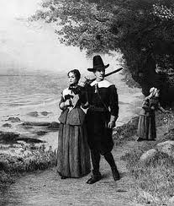
Brief History
Settled in colonies of New England in 1600’s
Valued hard work, effort, moral strength

Slide 5
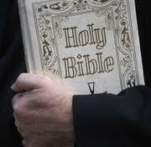
Puritan Beliefs
Supreme power of God
Prosperity was a gift from God
Moral and religious purity
Fought against developments of traditional Roman Catholics
Trust and faith in God
Private study of the Holy Bible
Education

Slide 6
Puritan Philosophy
Original Sin- Everybody a sinner, since everyone born of “original sin”
God chooses those worthy of salvation
Morality- Duty of all people to constantly examine their lives for sin, and live as purely as possible in all of their actions- private and public (“Puritan angst”).

Slide 7
Puritan Philosophy
Egalitarianism- People should have direct relationship with God
Education- People should be educated so they can read religious texts.
Founded several colleges (including Harvard)
Work Ethic- Activities outside of religious study and work were generally considered sinful
No holidays celebrated, not even religious ones (sinful).

Slide 8
Puritan Writings
God is the central aspect
Bible provides a model for Puritan writing
Used writing to find God in their lives
Plain and simple writing style

Slide 9
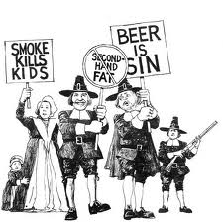
Puritan Societal Rule
No dancing, drinking, gambling, playing cards, ribaldry, (vulgar language in terms of humor or jokes) or fashionable clothes
Chief duty of man is to glorify God

Slide 10
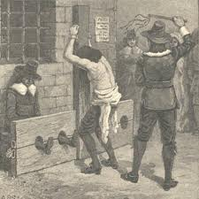
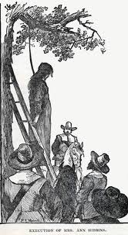
Sinners!
Deviating from religion resulted in:
flogging
pillorying
hanging
banishment

Slide 11
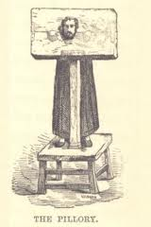
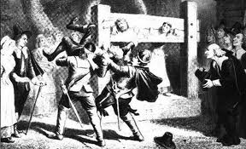
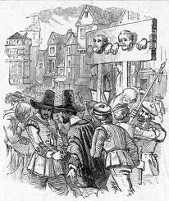
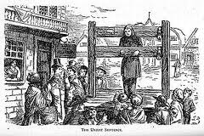

Slide 12
Puritan Code by Jonathan Edwards
Remember to read over these resolutions once a week:
4. Resolved, never to do any manner of thing, whether in soul or body, less or more, but what tends to the glory of God; nor be, nor suffer it, if I can avoid it.
6. Resolved, to live with all my might, while I do live.
7. Resolved, never to do anything, which I should be afraid to do, if it were the last hour of my life.
9. Resolved, to think much on all occasions of my own dying, and of the common circumstances which attend death.
12. Resolved, if I take delight in it as a gratification of pride, or vanity, or on any such account, immediately to throw it by.
14. Resolved, never to do any thing out of revenge.
15. Resolved, never to suffer the least motions of anger towards irrational beings.
16. Resolved, never to speak evil of anyone, so that it shall tend to his dishonor, more or less, upon no account except for some real good.
17. Resolved, that I will live so, as I shall wish I had done when I come to die.
20. Resolved, to maintain the strictest temperance, in eating and drinking.
21. Resolved, never to do any thing, which if I should see in another, I should count a just occasion to despise him for, or to think any way the more meanly of him.
22. Resolved, to endeavor to obtain for myself as much happiness, in the other world, as I possibly can, with all the power, might, vigor, and vehemence, yea violence, I am capable of, or can bring myself to exert, in any way that can be thought of.
23. Resolved, frequently to take some deliberate action, which seems most unlikely to be done, for the glory of God, and trace it back to the original intention, designs and ends of it; and if I find it not to be for God' s glory, to repute it as a breach of the 4th Resolution.
25. Resolved, to examine carefully, and constantly, what that one thing in me is, which causes me in the least to doubt of the love of God; and to direct all my forces against it.

