Slide 1
Othello The Moor of Venice

Slide 2
What is a Moor?
The term “moor” was derived from the name of the country Mauritania but was used to refer to:
North Africans
West Africans
Muslims (various origins)
Non-whites
Moors living in WHITE Elizabethan England were discriminated against for their dress, behavior and customs

Slide 3
Moors
They were stereotyped as:
Uncivilized
Barbaric
Sexually overactive
Prone to jealousy
Wicked
Morally corrupt
Devils
Having magical powers
Having tempers
Being villains

Slide 4
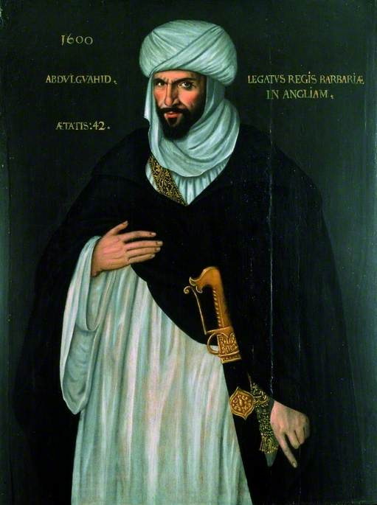
Ambassador of the King of Barbary (Morocco)
Morocco is the country north of Mauritania
Visited London in 1600
May have been inspiration for Othello

Slide 5
What do Elizabethans mean by black and white?
Shakespeare is writing largely BEFORE the height of the transatlantic slave trade.
Elizabethans would NOT have viewed Othello or a black person as a potential slave.
Began writing Othello 1601; first performed 1604

Slide 6
What do Elizabethans mean by black and white?
Black people—or Moors—and non-Europeans generally were viewed as foreign and foreigners were somewhat undesirable to Elizabethans.
Yet, Elizabeth granted Moors “full diplomatic recognition” for helping to fight Spain in the late 1500s.
Still, she deported Moors in 1601 citing their “irregular behavior” and fears that their presence would lead to overpopulation.

Slide 7
What do Elizabethans mean by black and white?
So…
Black = bad. Before European knowledge of people whom we would consider black, darkness and blackness were considered signs of evil.
White = good. “Fair” means both pale and morally good.

Slide 8
Identity and Blindness
Black/darkness/night/blindness
White/light/day/seeing
Watch the way these and related terms develop over the play.

Slide 9
Heroes and Villains
Shakespeare makes his hero black and his villain white—a departure from tradition in Elizabethan England.
Yet he incorporates racial stereotypes and prejudices into the plot and dialogue of his characters
Shakespeare challenges his audiences to judge Othello based on his words and actions – not on the stereotypes
Is he maintaining or subverting Elizabethan stereotypes about black people?
What is the true color of villainy?

Slide 10
Othello Terminology: Cuckold and Honesty
Honesty/honest = honesty (used over 40 times in the play!)
Honest = of lesser social standing (for a man) OR truthfulness
Honesty = chastity (always for a woman)
Cuckold: a man whose wife is unfaithful to him
Represented with horns growing out of his forehead

Slide 11
Othello is one of Shakespeare's greatest tragedies
The play itself is set in 16th century Venice and Cyprus against the backdrop of the wars between Italy and Turkey.
Jealousy is the ruling emotion of the play that plagues the tragic hero, Othello.

Slide 12
Typical Shakespearean Tragic Heroes:
1. exceptional beings – persons of high degree or public importance
2. often kings or military leaders (thus downfalls have great importance)
3. they cause their own downfalls (not by accident – instead the downfall proceeds from the hero’s own actions)
4. they possess a character FLAW

Slide 13
The Flaw
Due to the character flaw, the hero has a definite predisposition toward a particular mindset and action
As the play proceeds, all the hero’s efforts are directed toward one action, interest or objective
In time, he becomes incapable of resisting this end
Resulting in the DEATH of the hero
The fall provokes the emotions of pity and fear in the reader
The tragic character comes to some kind of understanding or new recognition of what has happened (too late of course)

Slide 14
Othello will address:
Romance
Love and Hate
Deception
Jealousy
Man’s distrust of women
Sexuality
Murder
Race, class, and gender issues
Violence
Betrayal
Vengeance
Pride
Appearance vs. Reality
Reputation
The nature of evil

Slide 15
Classic Tragedy vs. English Morality Play
Classic Tragedy
A hero of high standing
A tragic character flaw that becomes a driving force
Tragic flaw gains control through misunderstandings, supernatural suggestion, chance
Hero becomes isolated, does terrible things
Realizes too late his error
Makes a final display of courage or nobility
Is destroyed
English Morality Play
Middle ages “entertainment” to teach spiritual lessons
The hero is mankind
He is helped and hindered by personifications of good (Virtues) and evil (Vices) forces
Often various sins (pride, greed, gluttony) and death were personified
Elizabethan audiences still expected and recognized these elements

Slide 16
Everyman
Everyman confronts death and tries to get all his friends to go with him—including
Fellowship
Kindred
Goods
Strength
Beauty
Discretion
But only Good Deeds will come.
https://www.youtube.com/watch?v=vM5Zwd427iU
http://legacy.fordham.edu/halsall/basis/everyman.asp

