Slide 1
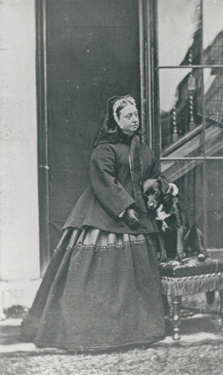
The Victorian Age
In the Victorian Age, which encompassed the last quarter of the nineteenth century, England was at its climax of power. The British Empire extended all over the world, coining the phrase, "The sun never sets in the British Empire."
The era saw the flourishing of the English aristocracy, but the rise of the elite created a wealth disparity between the very rich and the very poor.
Wilde, a member of the upper class, concentrated his satirical efforts on the aristocracy.

Slide 2
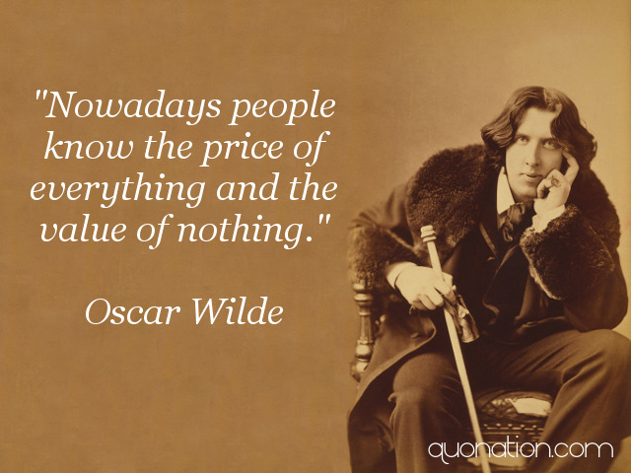

Slide 3
Wilde’s Epigrams
“I can resist everything except temptation”
“The truth is rarely pure and never simple”
“The first duty in life is to be as artificial as possible. What the second duty is no one has as yet discovered.”
“Industry is the root of all ugliness.”
“Pleasure is the only thing one should live for. Nothing ages like happiness.”

Slide 4
Oscar Wilde (1854-1900)
Next to his literature, Wilde is largely remembered for his flamboyant lifestyle and outrageous behaviour, at least as measured by the times in which he lived.
Educated at the University of Oxford, he wrote poetry, studied the classics and adopted a philosophy of "arts for art’s sake". It wasn’t uncommon to see him strolling through Picadilly Circus in London, outfitted with a velvet coat, knee breeches, and shoulder-length hair, carrying a lily.

Slide 5
Key Literary Terms (as elements of comedy)
A "comedy of manners“ : A comedy concerned with the social actions and behavior of members of a highly sophisticated, upper-class society, light, witty dialog and tone
Pun: a play on words (EARNEST)
Epigram: a short, witty, often paradoxical saying designed to surprise the audience.
Farce: a narrative with eloborate plots, absurd, rididulous events, often plot twists with mistaken identity and lies/deceptions

Slide 6
Key literary terms (as elements of comedy)
Irony – verbal, situational and dramatic
Parody – imitation and exaggerating it to produce a comedic effect
Satire – aims at correcting shortcomings in society by criticizing them/holding them up to ridicule
Incongruity – used in comedy and satire – inserts things into out of place environments – makes for absurd situations

Slide 7
Oscar Wilde, rather than focusing on the lower classes or social conditions, chose to satirize the life of the English aristocracy, a world with which he was personally familiar.
His characters are typical Victorian snobs; they are often arrogant, don’t seem to work at all, are overly proper, formal and concerned with money.
One of the ways Wilde's wit manifests itself is in puns: Running throughout the entire play is the double meaning behind the word earnest, as a male name and as an adjective for seriousness.
Wilde saw earnestness as being a key ideal in Victorian culture. Much of British society struck him as dry and conservative, and so concerned with the maintenance of social norms that it had become almost inhuman. The Importance lightly shows the limitations and unhappiness produced by such a way of life.

Slide 8
Play is written in 1895 – an immediate hit – a comedy in three acts
A satire mocking/criticizing Victorian morals, social values including those related to love, marriage, manners, education, religion to name a few

Slide 9
Social Basics for the Young Lady
Upon being introduced to a gentleman, a lady will never offer her hand. She should bow politely and say, “I am happy to make your acquaintance.”
When bowing on the street, it is appropriate to incline the head gracefully, but not the body.
A lady never looks back after anyone in the street, or turns to stare at them in the theater, concert hall, church, or opera.
In crossing the street, a lady raises her dress a little above the ankle, holding together the folds of her gown and drawing them toward the right. Raising the dress with both hands exposes too much ankle and is most vulgar.
* From Youth’s Educator for Home and Society of 1896

Slide 10
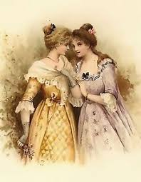
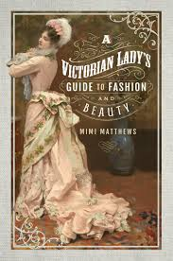
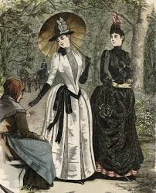

Slide 11
Social Basics for the Young Man
A gentleman will always tip his hat to greet a lady.
When walking in the street, the gentleman always walks on the outside to protect his lady from the dangers of the road.
If a gentleman is smoking and a lady passes by, he should remove the cigar from his mouth.
A gentleman should always rise when a lady enters or leaves a room.
During the daytime, a gentleman never offers a lady his arm unless to protect her in a large crowd. In the evening, it is appropriate for her to take his arm.
A gentleman should never place his arm on the back of a chair occupied by a lady.

Slide 12
