Slide 1
“It was a high counsel that I once heard given to a young person. ‘Always do what you are afraid to do.’”
Ralph Waldo Emerson
Relevance?
Agree?
Summarize in a word or two:

Slide 2
“The life which is unexamined is not worth living.”
Plato
Relevance?
Agree?
Summarize in a word:

Slide 3
“If man does not keep pace with his companions, perhaps it is because he hears a different drummer.”
Henry David Thoreau
Relevance?
Agree?
Summarize in a word or two:

Slide 4
Transcendentalism
An American literary, philosophical and political movement in the mid 1800s.
Mostly New Englanders attempting to create a uniquely American body of literature and philosophy
Transcendentalists were critics of their society for its unthinking conformity
Urged each individual to find and create a unique relationship with the universe.
HOW? Through NATURE

Slide 5
Transcend
To climb over, to go beyond
To move above common, everyday ideas and get to higher truths and insights

Slide 6
HOW?
Use your mind, spirit and intuition
Trust your soul, have faith in your inner voice
Take risks, never limit your possibilities

Slide 7
WHO?
Ralph Waldo Emerson
Henry David Thoreau
Margaret Fuller (finally)

Slide 8
WHEN?
Mid 1800s – an offshoot of the Romantic movement

Slide 9
WHAT?
Basic Beliefs:
The OVERSOUL
All knowledge begins with self-knowledge
Nature is a living mystery
The individual is the spiritual center of the universe (controversial)
God is in nature and human nature (oversoul, universal spirit)
Every individual is to be respected b/c everyone is part of the oversoul
Shares Romantic ideas of soul and death
Emphasis on self-reliance and thinking

Slide 10
Key Tenets of Transcendentalism
In Nature, we are able to "transcend" to higher truths and connections in the universe. (meditation – a more modern interpretation) Materialism is destructive. Striving for material goods is a worthless and unhealthy pursuit. It is superficial and can only lead to corruption.

Slide 11
Key Tenets of Transcendentalism
Society is the source of corruption. If we are all to follow our own free will and listen to our hearts, we would be much better off. Societal/governmental norms and rules are counterintuitive.
Our intuition and natural instincts guide us to make the right choices. In nature, we are uncorrupted. It is only when we let society in that we start to conform and hence, be corrupted.

Slide 12
Key Tenets of Transcendentalism
Conformity is wrong. We should NOT follow the crowd. We should make our own way and our own decisions in this world in order to truly embrace our uncorrupted intuition. The nature of human beings is good. Again, it is society that corrupts us. Human beings left to their own devices are good.

Slide 13
Key Tenets of Transcendentalism
Knowledge comes from experience. True knowledge is not derived from reading books or studying. It comes from living. God is everywhere and in everything. The Transcendentalists did not need organized religion because they wanted that direct relationship with God, not one through a pastor or a priest.
All things are interconnected. The LIFEFORCE or OVERSOUL that exists everywhere also connects everything (“The force is great with this one”)

Slide 14
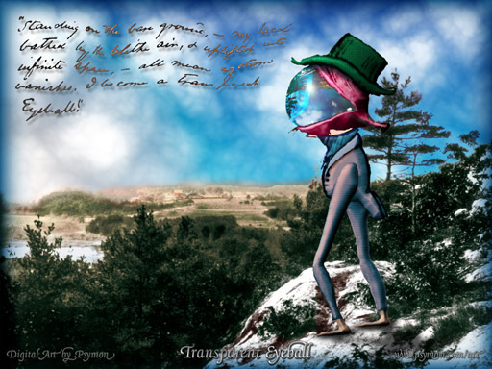
Key Players
Ralph Waldo Emerson
Nature, Self Reliance
transparent eyeball
“I become the transparent eyeball. I am nothing; I see all; The currents of the universal being circulate through me.”

Slide 15
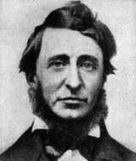
Key Players
Henry David Thoreau
lived alone in cabin on Emerson’s land on Walden Pond for 2 years
Famous for Civil Disobedience and Walden
Not considered a successful writer during his lifetime

Slide 16
Henry David Thoreau 1817-1862
Transcendental author, mentored by Emerson
Acknowledged “most men think differently from myself.”
From Concord, MA
Harvard educated (like Emerson)
Very eccentric – many criticized him for not following a prescribed career (lawyer, businessman)
Instead – odd jobs – carpentry, gardening, teaching, factory work
Worked only enough to sustain himself

Slide 17
“Civil Disobedience”
ACTIONS PARALLELED HIS BELIEFS!
Even as a young man he was a non-conformist (student and teacher examples)
Anti-slavery, anti-war
Refused to pay a poll tax as it was supporting the war with Mexico and slavery
Spent a night in jail for that act of disobedience
Inspired him to write “Civil Disobedience” in 1849
Later studied internationally by the likes of Gandhi and Martin Luther King, Jr.
Helped slaves escape to Canada

Slide 18
Walden
Book about his experience living at Walden Pond on Emerson’s land (published in 1854)
Wanted to live SIMPLY, DELIBERATELY, and learn from EXPERIENCE
Built a tiny, crude, one room house, one fireplace, 2 windows, 10’ x 15’. Spent about $12.00 to build
Moved in, alone, July 4th, 1845, began to write
Book moves through the seasons – condensed over his two years there
Walden Pond now a National Historic Landmark

Slide 19
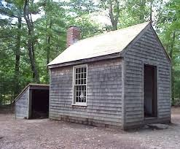
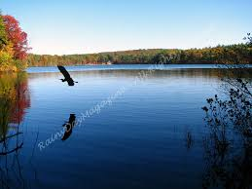
Walden Pond

