Slide 1
Beloved
Toni Morrison

Slide 2
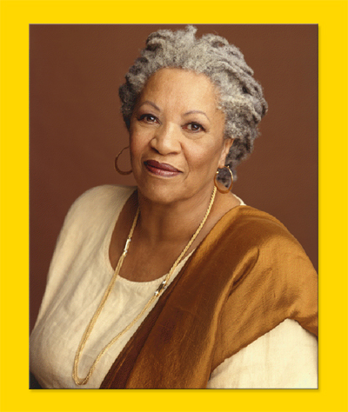
Toni Morrison
11 novels
2 plays
1 libretto
Lots of non-fiction articles and essays
Pulitzer Prize for Fiction 1988
Nobel Prize for Literature 1993

Slide 3
Beloved
This novel deals with the past and the present of a family comprised of Sethe (mother) Baby Suggs (Sethe’s mother-in-law, grandmother of Denver) and Denver (daughter of Sethe).
The past takes place before the Civil War in Kentucky on a farm called Sweet Home.
The present takes place soon after the war—in 1873—at the house where the family lives, called 124 Bluestone.
Unless noted as white people in the character chart below, all the characters are enslaved (PAST) or formerly enslaved (PRESENT) people—except Denver who managed to be born free.

Slide 4
Style
This novel uses free, indirect discourse, in which the narration remains in 3rd person omniscient, but slips fluidly in and out of the minds of different characters so we can see what they are thinking and feeling.
This is 3rd person narration with a 1st person feel.
The narration slips in and out of various characters’ minds, so pay attention to whose thoughts you are reading.

Slide 5
Style
Not only does the novel slip fluidly between different characters’ minds, it also slips fluidly from the present to the past and back again.
It is a non-linear timeline
You’ll have to pay close attention to distinguish what is happening in the present from what a character is remembering about the past.
Using the Past and Present characters slide and the General Timeline slide at the end of this PowerPoint may help you keep track of the order of events

Slide 6
Major Ideas
There is a lot going on in this beautiful novel, but we are going to focus primarily on this idea:
The past and the effect the past has on the present; how one determines what to preserve from the past; how one can move on from an overpoweringly negative past and create a future.
Specifically, this novel addresses how a person who suffered through slavery can continue with their life without being destroyed by their past.

Slide 7
Other Major Ideas
Closely related to those ideas are ideas of community, isolation, family, and identity
This novel specifically addresses how people who were enslaved, and as a result had their families and identities altered and destroyed by others, create coherent families, communities, and identities in the aftermath.
It exposes the horrific external abuses of slaves but also and more importantly reveals the internal lives of slaves
Be prepared for disturbing and upsetting imagery of the external abuses

Slide 8
Major Ideas Continued
Guiding Question: Is it possible for a slave woman to have a moral compass while under the institution of slavery?
Because there is so much going on in the novel, try to think about how what you read builds on these major ideas to give your reading a focus.

Slide 9
PRESENT
124 Bluestone Cincinnati, Ohio
PAST
Sweet Home, Kentucky
Paul A., Paul D., Paul F., Sixo, Halle (enslaved men on Garner farm Sweet Home)
Sethe (enslaved woman, bought by Garners when she is 14 and marries Halle)
Howard and Buglar (Sethe and Halle’s two small boys)
Thirty Mile Woman (Sixo’s wife on another farm)
Mr. and Mrs. Garner (white; owners of Sweet Home)
Schoolteacher (white; Mrs. Garner’s brother-in-law)
Baby Suggs (Halle’s mother, previously owned by Garners; Halle bought her freedom with extra work; now lives in 124)
Sethe (lives with Baby Suggs after escaping)
Paul D. (finds Sethe in 1873 at 124)
Howard and Buglar (Sethe’s sons)
Denver (Sethe’s daughter born as she escaped; currently 18)
Beloved
Ella and John (formerly enslaved)
Stamp Paid (formerly enslaved; helps escaped slaves)
Lady Jones (formerly enslaved; teachers black children)
Mr. and Mrs. Bodwin (white; abolitionists)

Slide 10
WARNING! On the next slide are MINOR spoilers. If you don’t want ANY spoilers, don’t look : ) It is a general timeline of events. Because the novel moves backward and forward throughout time as characters reflect on their past, the slide might be useful for you.

Slide 11
General Timeline
Garner buys Baby Suggs (50) and Halle (10) and brings them to Sweet Home, Kentucky, where they are enslaved alongside Paul A., Paul D., Paul F., and Sixo.
10 years later, Halle (20) buys his mother’s (60) freedom by agreeing to extra work. Baby Suggs goes to 124 Cincinnati, Ohio.
Sethe is bought by Garner when she is 14, marries Halle, and has two boys, Buglar and Howard, and a baby girl with him.
At some point close to 1855 Garner dies, and Mrs. Garner asks her brother-in-law to live on Sweet Home and help run it. He is brutal and the enslaved begin planning an escape.
1855 Sethe, heavily pregnant, escapes, after sending her children ahead, and joins children and Baby Suggs at 124. During the escape, Denver is born. After 28 days at 124 Bluestone, THE EVENT happens. The escape itself goes awry and things happen to Paul D., Sixo and Halle in the immediate aftermath.
Between 1855 and 1873, Paul D. is sold away from Sweet Home, imprisoned in Alfred, Georgia, escapes, fights in the war, and makes his way to the North.
1863-64 Sethe’s sons Howard and Buglar leave. Baby Suggs dies.
1873 Paul D. finds Sethe and Denver at 124 and the PRESENT events of the novel take place. Denver is 18. Soon after Paul D. arrives, Beloved shows up.

Slide 12
