Slide 1
Into the Wild
“I've decided I'm going to live this life for some time to come. The freedom and simple beauty is just too good to pass up.” ~Christopher McCandless

Slide 2
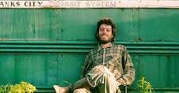
Into the Wild
Chris McCandless – aka Alex Supertramp

Slide 3
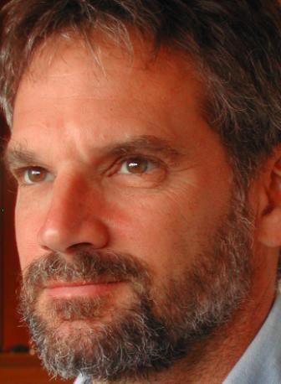
The Author
Jon Krakauer is a writer and avid mountain climber.
Krakauer’s writing career picked up with Outside magazine, but he has written for many other publications including The New York Times
He has written several novels, the most acclaimed being Into Thin Air, an account of his successful yet disastrous climb of Mount Everest

Slide 4
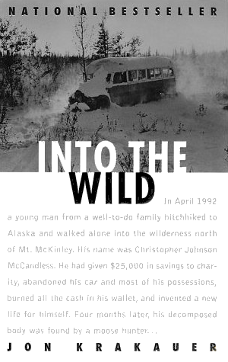
The Book
Into the Wild was published in 1996 and spent two years on the NYT Bestseller List
He wrote the book after the success and great popularity of his Outside article on Christopher McCandless published in the January 1993 issue.

Slide 5
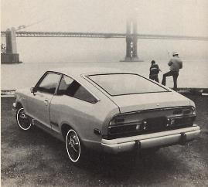
Chris McCandless
High Achiever: Academics, Athletics, Music * Entrepreneurial
Generous & Caring *Cold & Unforgiving
Impatient with others
Self-absorbed Harsh judge of parents
Tolerant of artists& close friends
Passionate
Self-righteous
Intensely private
Gregarious (social)
Socially conscious
Examining his character traits, why do you think he decided to leave it all behind? Answer in groups on response boards

Slide 6
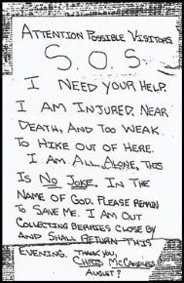
Methodology
Krakauer’s use of methodology in Into the Wild is an important focus of his biography. It is inevitably what makes him a “partial” biographer.
Methodology: the methods of organizing principles underlying a particular art, science or other area of study.
*Manuscripts
*Maps
*Interviews
*Epigraphs – short quotes or sayings at
the beginning of books and/or chapters used
to suggest meaning or theme

Slide 7
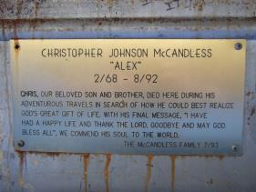
Structure
Krakauer starts the novel with the ending completely in mind.
We know of Chris’fate by chapter two.
The epigraph is detailing his trip into the Yukon Territory.
Westerberg’s letter is introduced before he is.
How is this effective story telling?
Why are we given the letter before a literary quote?

Slide 8
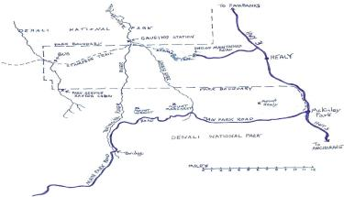
Maps
The maps are used to personalize the odyssey.
Visual rendering of where he’s been. We see Chris’s plight and the trek he has made.
Also see the absurdity of his journey: jumping from one place to the next.

Slide 9
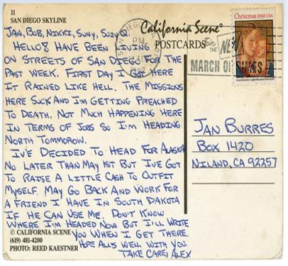
Letters and Manuscripts
Personal connection to Chris.
He seems very candid and real in the letters.
Detection of his spite, anger and arrogance in the letters.
Puts on a different face in front of strangers: benevolent, spirited, kind.
The letters serve as his connection to the outside, evidence of his journey, and his bitter farewell to society.

Slide 10
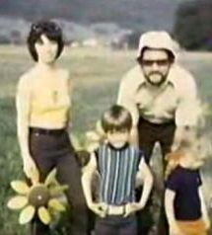
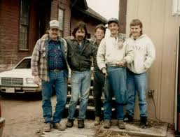
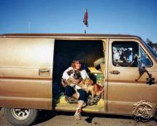
Interviews
Story becomes real when we meet people Chris has befriended.
Provide personal account of his behavior.
Allow us to question his motives.
Aware of his inability to connect to humans.
Krakauer’s main attempt at being impartial.

Slide 11
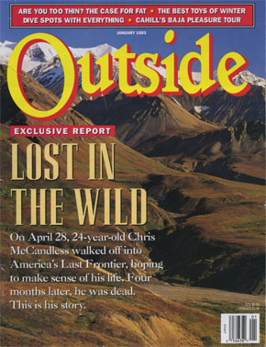
The Article that Started it All!
[Original article]Death of an Innocent: How Christopher McCandless lost his way in the wilds

Slide 12
The Krakauer-McCandless Connection
Krakauer saw a lot of connections between Chris and himself from their interests, to their world views, to their family lives.
“I identify with him a lot, and it's a sad story. I went back to the bus for the third time last September. I've become quite good friends with his family, we have sort of this weird bond” (Random House).
[Movie Interview]: Why and how Krakauer wrote the book

Slide 13
A look Into the Wild
[Outside link] Recovered photos from McCandless’ camera
[Outside article] A treasure trove of unpublished letters and never seen photos offers a fresh perspective on the adventures of Christopher McCandless

Slide 14
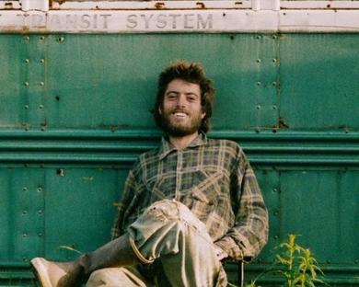
Essential Questions
Heroes often embody the qualities of a culture. Examine McCandless as a possible hero. What evidence is there that he’s a hero to Americans? What qualities does he have that represent our own culture and what we value?
In what ways do the ideas of the transcendentalists resonate in modern America?

Slide 15
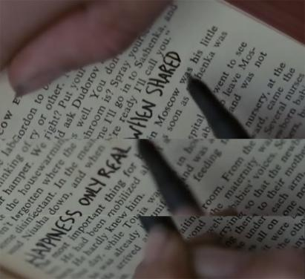
Essential Questions
In life, what is most important: friends, family, or self? Are families, friends, or community essential to our happiness in any way? Can a person be completely content in solitude or without the acceptance of society? Which of these is most central to our happiness?
What does it mean to be successful?

Slide 16
Essential Questions
How do we construct our own identities? What is the relationship between nature and the identity of Americans? In what other ways do we form our identities? What is your identity?
Americans have always been captivated by the idea of traveling west, or as Wallace Stegner wrote, “the road has always led west” (15). Why do Americans have such an obsession with travel, the road, and the road trip? What does it reveal about our culture and our desires that many people seek out the adventure of the great unknown?

Slide 17
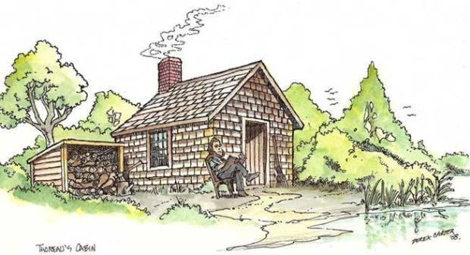
Essential Questions
What is your purpose? What is McCandless’? What can you learn about your own purpose from examining his?

Slide 18
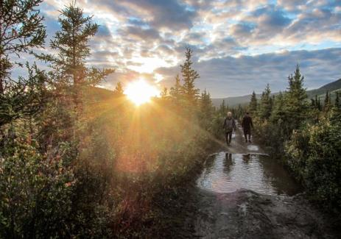
Yet another bonus!
Print, read, and annotate Outside magazine's article “The Chris McCandless Obsession Problem”

Slide 19
Extras
We’ll check these out later
Google Map of Chris’/Alex’s journey
Prezi Map of Chris’/Alex’s journey
September 2013 NPR interview “Did Jon Krakauer Finally Solve 'Into The Wild' Mystery?”

