Slide 1
1950s
Conformity vs. Counterculture

Slide 2
Essential Questions
Was conformity something people wanted, or did they feel obligated to conform? (choice vs. force)
What role did gender, age and race play in the 1950s?
How did people use fear to force conformity?
What is the ideal 1950s family? What is the real 1950s family?

Slide 3
Pleasantville – To get a better idea of the 1950s, I suggest watching this film. The following are helpful questions to prepare you for the poetry to come that was written in reaction to the mainstream culture of the era.
What were the family values of the 1950’s? What were the roles of each of the family members?
What was valued most in society during the 1950’s?
What did the ideal 1950’s man look like? What did the ideal 1950’s woman look like?
What commentary is the movie making about conformity?
Why does the movie change from black and white to color?
David claims the people “are happy like this”. Do you think the people of the 1950’s were really happy? Explain with evidence from the film.
Why did people resist change in the 1950's?
What does the trial scene remind you of? Why?
What does the last scene mean?

Slide 4
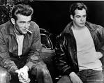
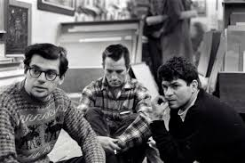
Beat Movement Literature of the 1950s

Slide 5
When?/Where?
America post-World War II
Primarily during the 1950s
San Francisco and New York were the hubs of the movement

Slide 6
What?
Counterculture movement
Non-conformity and spontaneous creativity
Term ‘beat’ from writer Jack Kerouac
Meaning tired or beaten down
Also: upbeat, rhythm of poetry, jazz
Characterized by drug use, sexuality, liberal perspectives, bohemian lifestyle
Interested in changing consciousness and defying conventional writing
The beatniks were the pre-hippies

Slide 7
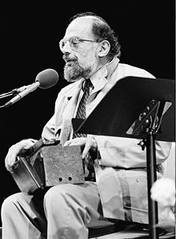
Allen Ginsberg (1926-1997)
Leading figure of beatniks
The Beat Generation emerged around the idea of NONCONFORMITY.
Beat authors were not a part of suburban America and didn’t want to be.
They were defined by rebellion and disillusionment
Opposed militarism, materialism and
sexual repression
Howl, America (two of his popular works)
Styled after epic, free verse of
Walt Whitman
Mostly poetry

Slide 8
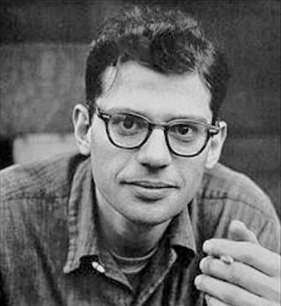
Allen Ginsberg (cont.)
• Born in New Jersey
• Attended Columbia University – met
other writers in NYC – formed “Beat Generation” (1950s)
• A group of young artists, writers and intellectuals who rejected mainstream society and favored Zen Buddhism, modern jazz, free sexuality, and recreational drugs.
• Wrote about conformity, materialism and hypocrisy they witnessed in society
• His works were so controversial and scandalous the police seized his publication, banned it as too obscene and arrested the publisher and bookstore manager for selling his poetry!
• An obscenity trial soon followed – judge ruled in favor of Ginsberg saying his book did have redeeming social value
• His mother’s mental illness and death in a psychiatric ward haunted him and influenced some of his best poetry
• An outspoken activist idolized by the “hippie” generation to come (1960s,70s)
• Embodied ideals of freedom, non-conformity and personal enlightenment

Slide 9
Ginsberg’s Characteristics
Liberation: sexual, religious, racial
Liberation of the world from censorship
Make drugs normal and legal
Rhythm and blues/rock and roll/jazz as a high art form
The spread of ecological consciousness, "Fresh Planet"
Opposition to the military-industrial machine
Respect for land and indigenous people/creatures
Does any of this remind you of TRANSCENDENTALISM?

Slide 10
“A Supermarket in California” Ginsberg - 1955
What thoughts I have of you tonight, Walt Whitman, for I walked down the sidestreets under the trees with a headache self-conscious looking at the full moon. In my hungry fatigue, and shopping for images, I went into the neon fruit supermarket, dreaming of your enumerations! What peaches and what penumbras! Whole families shopping at night! Aisles full of husbands! Wives in the avocados, babies in the tomatoes!—and you, Garcia Lorca, what were you doing down by the watermelons? I saw you, Walt Whitman, childless, lonely old grubber, poking among the meats in the refrigerator and eyeing the grocery boys. I heard you asking questions of each: Who killed the pork chops? What price bananas? Are you my Angel? I wandered in and out of the brilliant stacks of cans following you, and followed in my imagination by the store detective. We strode down the open corridors together in our solitary fancy tasting artichokes, possessing every frozen delicacy, and never passing the cashier. Where are we going, Walt Whitman? The doors close in an hour. Which way does your beard point tonight? (I touch your book and dream of our odyssey in the supermarket and feel absurd.) Will we walk all night through solitary streets? The trees add shade to shade, lights out in the houses, we'll both be lonely. Will we stroll dreaming of the lost America of love past blue automobiles in driveways, home to our silent cottage? Ah, dear father, graybeard, lonely old courage-teacher, what America did you have when Charon quit poling his ferry and you got out on a smoking bank and stood watching the boat disappear on the black waters of Lethe?
Berkeley, 1955

Slide 11
“A Supermarket in California” Ginsberg
First impressions?
Connections to Ginsberg’s life that might help you understand the poem?
Allusions (recall an allusion is a reference to anything commonly known – could be a reference to a famous place, person, religious figure, a character, etc.) – how do they add to the poem’s meaning? Choose at least TWO allusions, be clear on what they are - this will help you understand the poem.
(Why Walt Whitman?)
Unknown vocabulary? Choose and define at least two.
What do we know about the speaker in this poem? How would you characterize this speaker?
Sensory imagery? Provide an example that lends meaning to the poem.
Mood? We worked extensively with MOOD in the Gothic unit. What is the mood of this poem? How do you know? Recall – authors use setting and diction to create mood.
Other poetic devices – alliteration, figurative language, symbols, etc. Choose ONE than stands out to help create meaning.
Overall message/theme?
Your opinion of/reaction to the poem?

Slide 12
“My Sad Self” - Ginsberg
Sometimes when my eyes are red
I go up on top of the RCA Building
and gaze at my world, Manhattan—
my buildings, streets I’ve done feats in,
lofts, beds, coldwater flats
—on Fifth Ave below which I also bear in mind,
its ant cars, little yellow taxis, men
walking the size of specks of wool—
Panorama of the bridges, sunrise over Brooklyn machine,
sun go down over New Jersey where I was born
& Paterson where I played with ants—
my later loves on 15th Street,
my greater loves of Lower East Side,
my once fabulous amours in the Bronx
faraway—
paths crossing in these hidden streets,
my history summed up, my absences
and ecstasies in Harlem—
—sun shining down on all I own
in one eyeblink to the horizon
in my last eternity—
matter is water. Sad,
I take the elevator and go
down, pondering,
and walk on the pavements staring into all man’s
plateglass, faces,
questioning after who loves,
and stop, bemused
in front of an automobile shopwindow
standing lost in calm thought,
traffic moving up & down 5th Avenue blocks behind me
waiting for a moment when ...
Time to go home & cook supper & listen to
the romantic war news on the radio
... all movement stops
& I walk in the timeless sadness of existence,
tenderness flowing thru the buildings,
my fingertips touching reality’s face,
my own face streaked with tears in the mirror
of some window—at dusk—
where I have no desire—
for bonbons—or to own the dresses or Japanese
lampshades of intellection—
Confused by the spectacle around me,
Man struggling up the street
with packages, newspapers,
ties, beautiful suits
toward his desire
Man, woman, streaming over the pavements
red lights clocking hurried watches &
movements at the curb—
And all these streets leading
so crosswise, honking, lengthily,
by avenues
stalked by high buildings or crusted into slums
thru such halting traffic
screaming cars and engines
so painfully to this
countryside, this graveyard
this stillness
on deathbed or mountain
once seen
never regained or desired
in the mind to come
where all Manhattan that I’ve seen must disappear.

Slide 13
“My Sad Self”
First impression?
Comparisons to previous poem?
Connections to Ginsberg’s life?
Unknown vocabulary words? Choose and define a few.
What is the dramatic situation? That means where and when and what is going on in the poem on the literal level.
Who is the speaker? What do you know about the speaker? How would you characterize this speaker?
What is the mood?
What are the predominant emotions expressed?
What do you think the poem means?
Even if the readers have never been to NYC, how can they have a connection to this poem and its meaning?

Slide 14
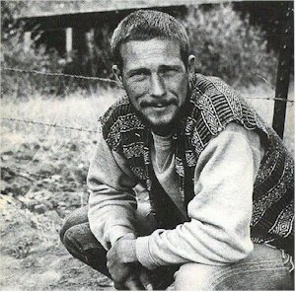
Gary Snyder
Born in 1930
Contemporary of Allen Ginsberg and other Beat
Generation writers of the 50s and 60s
(though he did not like to be classified as such)
Raised in Washington and Oregon
Deep respect for Native American culture
Study of Native Americans influenced him to adopt a lifestyle in harmony with nature (preservation of natural world)
Has mixed his life with hard, physical, outdoor labor and various intellectual pursuits
Traveled extensively – moved to Japan at age 26 – studied Eastern culture
Spent next 12 yrs. traveling India, Indonesia, Istanbul and beyond
Became immersed in Zen Buddhism
“My poems may approach the true measure of things and stand against the unbalance and ignorance of our times.”

Slide 15
“I Went into the Maverick Bar” - Snyder
I went into the Maverick Bar
In Farmington, New Mexico.
And drank double shots of bourbon
backed with beer.
My long hair was tucked up under a cap
I’d left the earring in the car.
Two cowboys did horseplay
by the pool tables,
A waitress asked us
where are you from?
a country-and-western band began to play
“We don’t smoke Marijuana in Muskokie”
And with the next song,
a couple began to dance.
They held each other like in High School dances
in the fifties;
I recalled when I worked in the woods
and the bars of Madras, Oregon.
That short-haired joy and roughness—
America—your stupidity.
I could almost love you again.
We left—onto the freeway shoulders—
under the tough old stars—
In the shadow of bluffs
I came back to myself,
To the real work, to
“What is to be done.”

Slide 16
“I Went into the Maverick Bar”
What is a maverick? Is there any irony in this title?
Why does the speaker put his hair under his cap and take out his earring?
What is the significance of the song the band plays? How does it add meaning to the poem?
Why does the speaker comment on how the couples are dancing?
Based on the poem, what is stupid about America? Why is the speaker struggling to love America?
What do you think there “is to be done”?

Slide 17
“Axe Handles” - Synder
One afternoon the last week in April
Showing Kai how to throw a hatchet
One-half turn and it sticks in a stump.
He recalls the hatchet-head
Without a handle, in the shop
And go gets it, and wants it for his own.
A broken-off axe handle behind the door
Is long enough for a hatchet,
We cut it to length and take it
With the hatchet head
And working hatchet, to the wood block.
There I begin to shape the old handle
With the hatchet, and the phrase
First learned from Ezra Pound
Rings in my ears!
"When making an axe handle
the pattern is not far off."
And I say this to Kai
"Look: We'll shape the handle
By checking the handle
Of the axe we cut with—"
And he sees. And I hear it again:
It's in Lu Ji's Wên Fu, fourth century
A.D. "Essay on Literature"-—in the
Preface: "In making the handle
Of an axe
By cutting wood with an axe
The model is indeed near at hand."
My teacher Shih-hsiang Chen
Translated that and taught it years ago
And I see: Pound was an axe,
Chen was an axe, I am an axe
And my son a handle, soon
To be shaping again, model
And tool, craft of culture,
How we go on.

Slide 18
“Axe Handles” - Synder
Connections to poet’s life?
Who is the speaker and what is he expressing?
What is an effective example of imagery?
Main symbols and/or metaphors?
Any allusions that add to the meaning of the poem?
Overall message/theme?
Any personal connections to your experiences?
OVERALL INTERPRETATION: Any connections/similarities between Ginsberg and Snyder poems? What is the common thread?

Slide 19
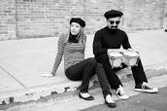
Beats today
If the beatniks were popular today, what social issues do you think they would write about?

